Slide 1
Digital public health interventions: potential and challenges
Lucy Yardley, Mark Weal & Paul Little
Faculty of Social and Human Sciences
on behalf of the LifeGuide/UBhave team and collaborators

Slide 2
Potential and challenges of digital interventions for public health interventions
Valued by users for convenient, private, instant access to personalised, expert and peer support to help achieve goals
Attractive to providers as scalable – potentially wide reach at low cost per person
BUT
Effect sizes often small, dropout from interventions high
Already tens of thousands of untested, often unhelpful apps for health-related behaviour change

Slide 3
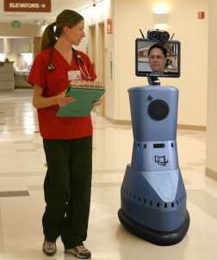
Multidisciplinary challenge facing digital interventions
The technological challenge – generating flexible, affordable and accessible methods of creating digital interventions
The behavioural challenge – creating digital interventions that patients and clinicians find accessible, engaging, trustworthy, useful

Slide 4


A solution: LifeGuide and UBhave
unique software pioneered at UoS for creating digital interventions for PC, tablet, smart phone
open source, free – can be used:
by new researchers, students
for pilot work
by lower income countries

Slide 5
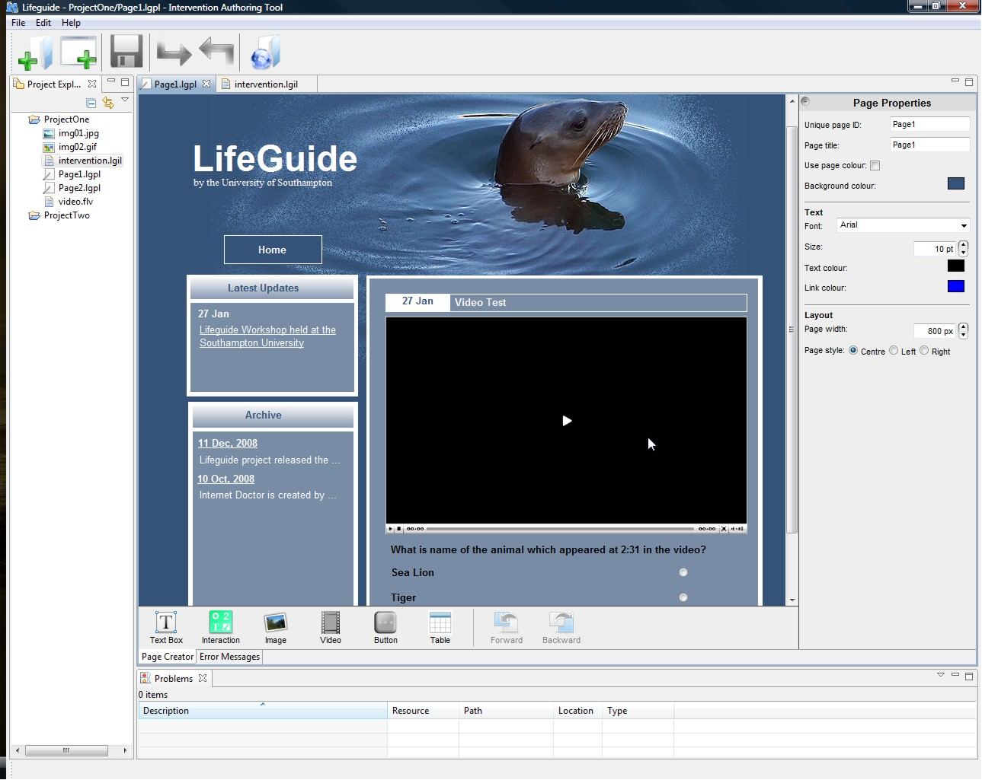
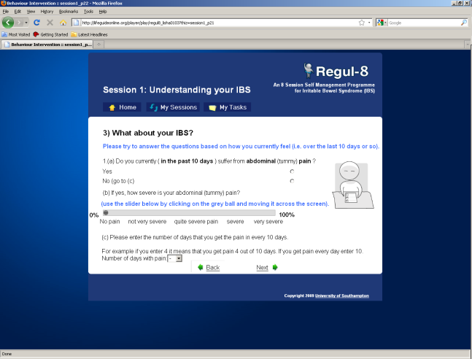
What can you do in LifeGuide?
Create questionnaires, graphs of users’ progress over time
Deliver tailored advice based on diagnostic questions, charted progress
Create look and feel, add images and videos
Send automated emails and text messages (e.g. reminders)

Slide 6
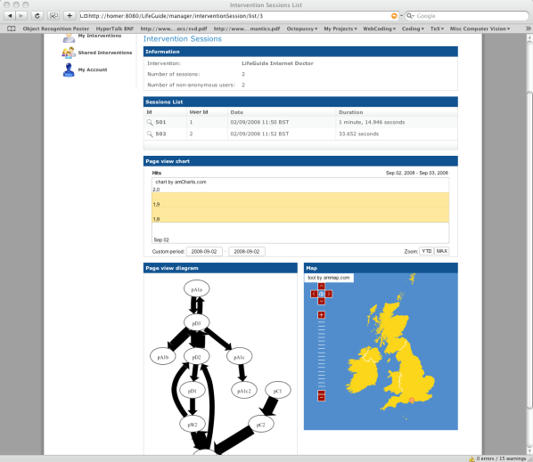
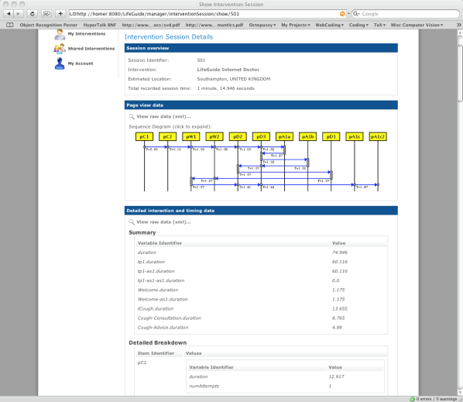
What can you do in LifeGuide?
screening and multi-user registration
stratified randomisation
automated baseline and follow-up assessment
monitoring throughput and adherence (all website usage recorded in detail)
output all data to Excel

Slide 7
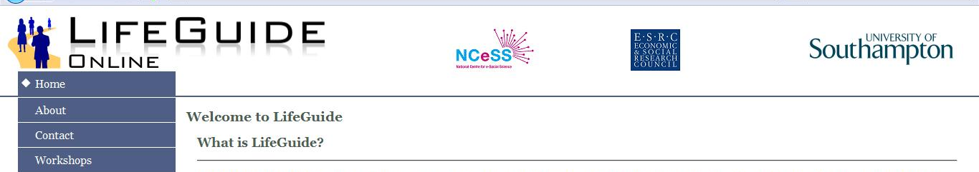
Advantages of the LifeGuide: flexibility
allows very flexible iterative development over time (e.g. after multiple pilots, trials etc.)
you can modify your interventions in the future (e.g. for dissemination, when circumstances change, for other contexts)
you can ‘copy and paste’ interventions or parts of interventions for other purposes

Slide 8
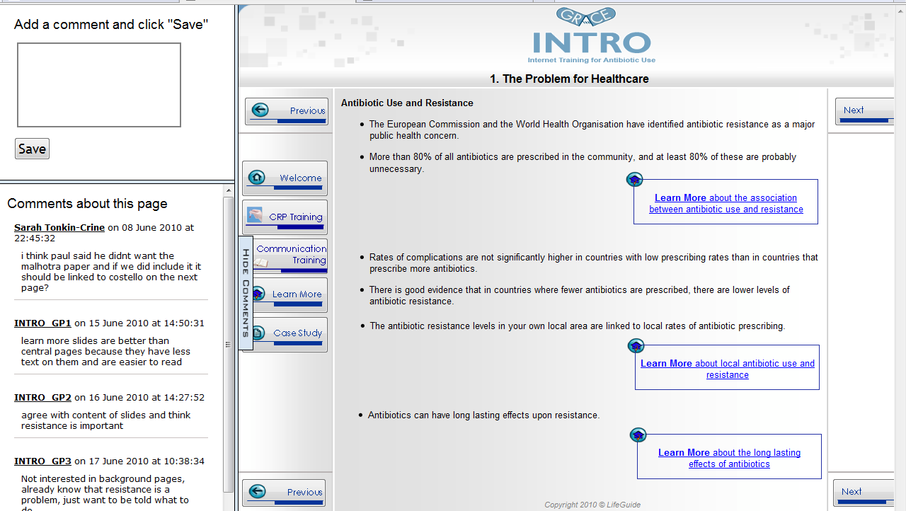
LifeGuide community comment facility

Slide 9
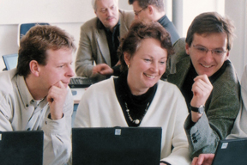
Advantages of the LifeGuide: collaboration
LifeGuide Community Virtual Research Environment supports joint development by large, dispersed teams
easy modification supports (international) sharing of interventions or components (e.g. translation into different languages, adding context-specific advice)
reduces time and costs caused by duplication of programming for interventions (liked by funders!)

Slide 10

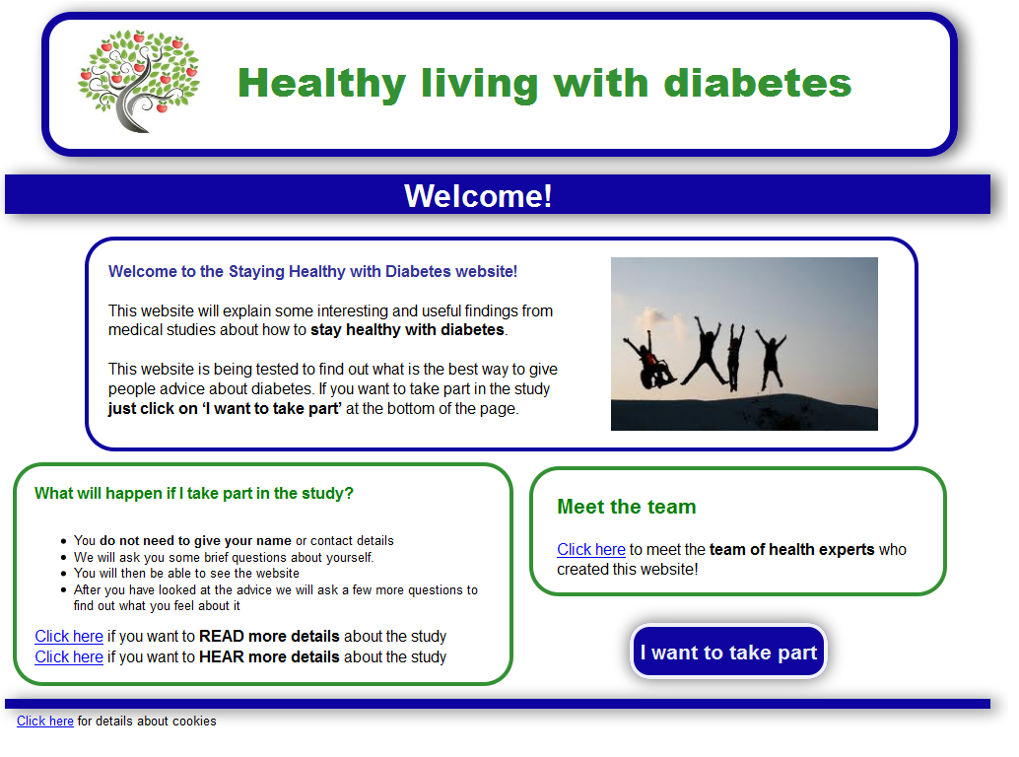
Example 1: Diabetes Literacy
EC-funded study to investigate whether interactivity and graphics can make public e-health interventions MORE accessible to those with lower levels of health literacy
Website evaluated by qualitative research in UK, USA, Ireland, Germany Austria (Alison Rowsell’s talk Session 2)
Website will be compared with text only version in trials in all these countries plus Taiwan (2014-2015)

Slide 12
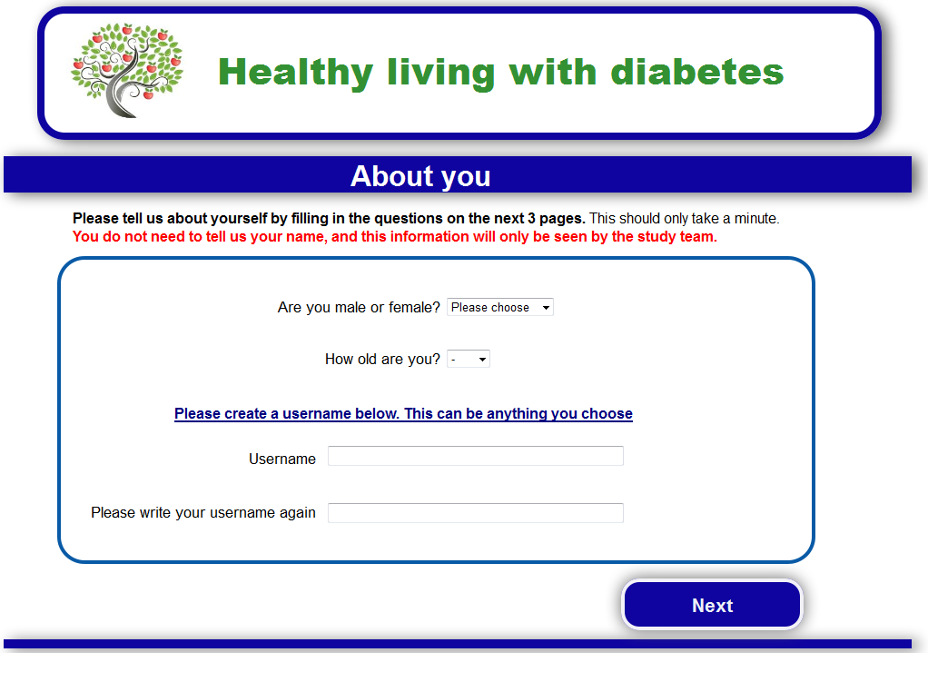

Slide 13
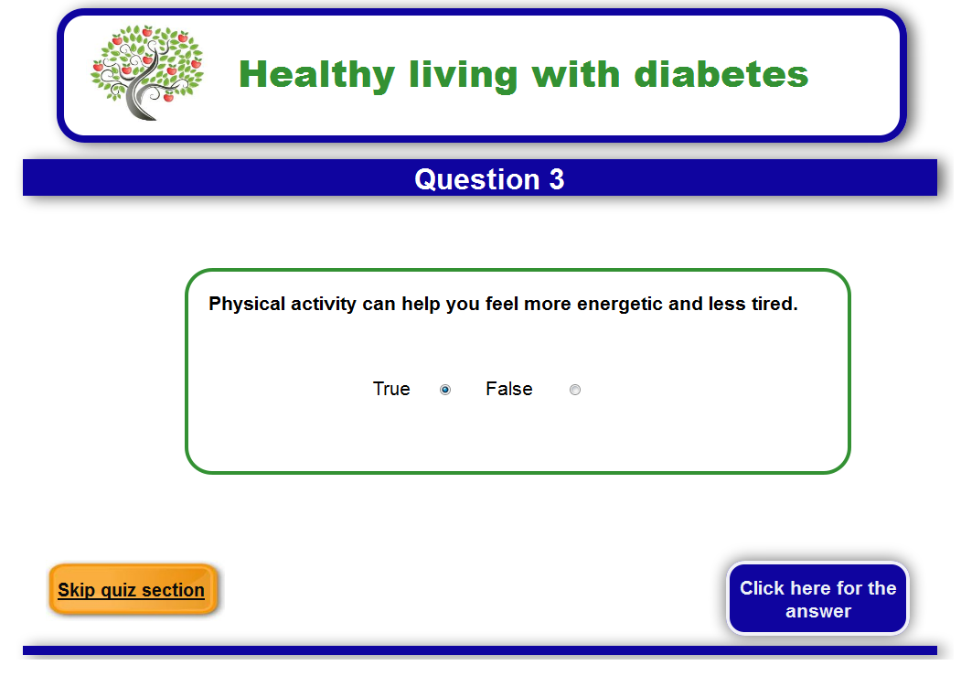

Slide 14
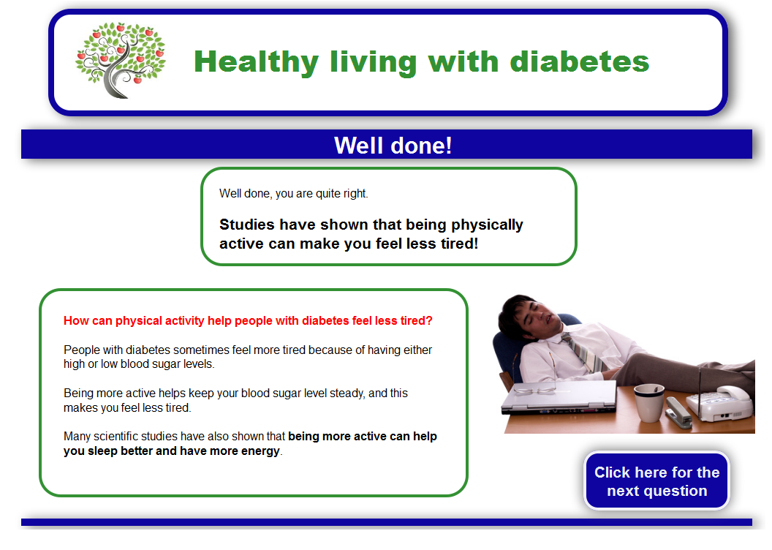

Slide 15
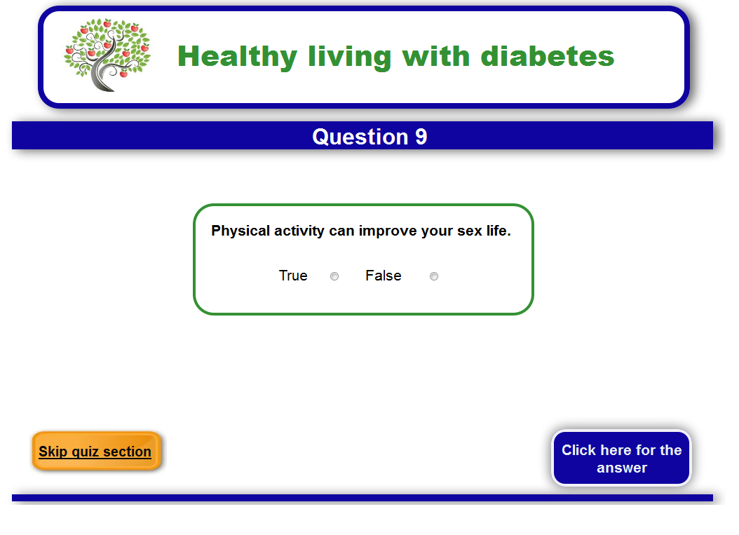
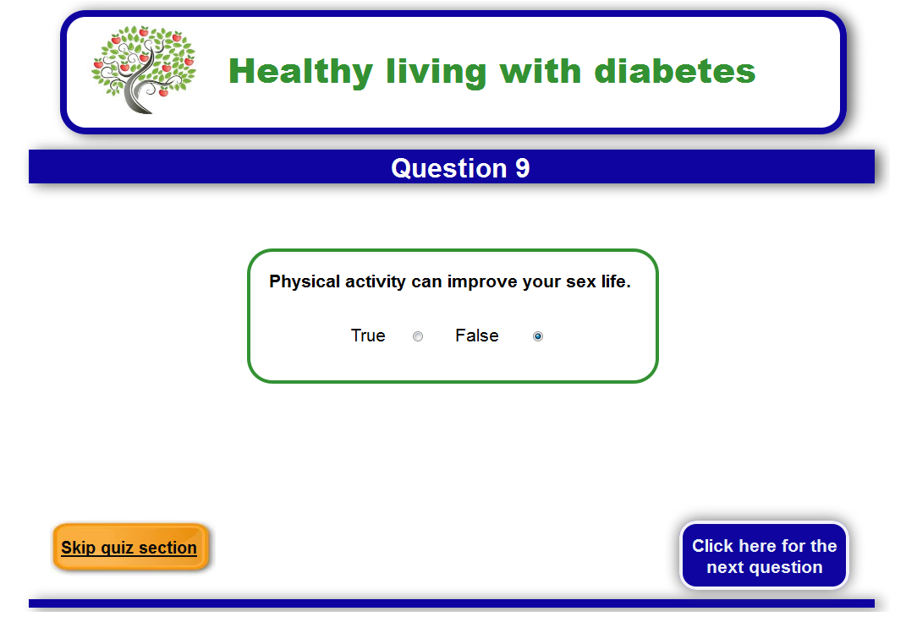

Slide 16
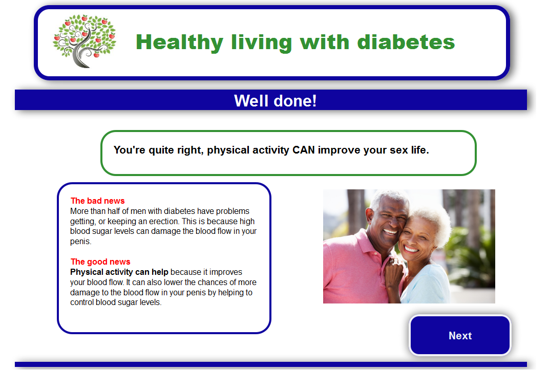

Slide 17
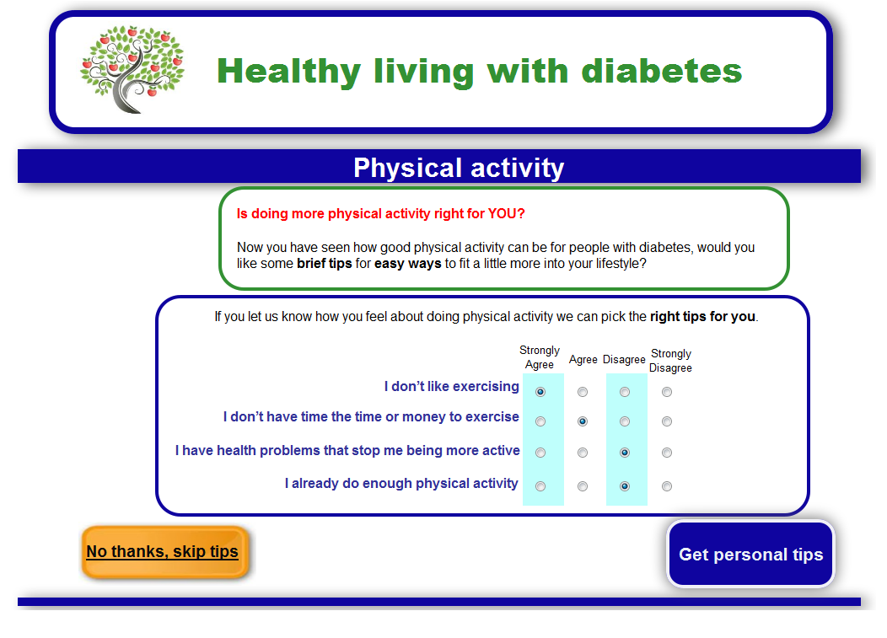

Slide 18
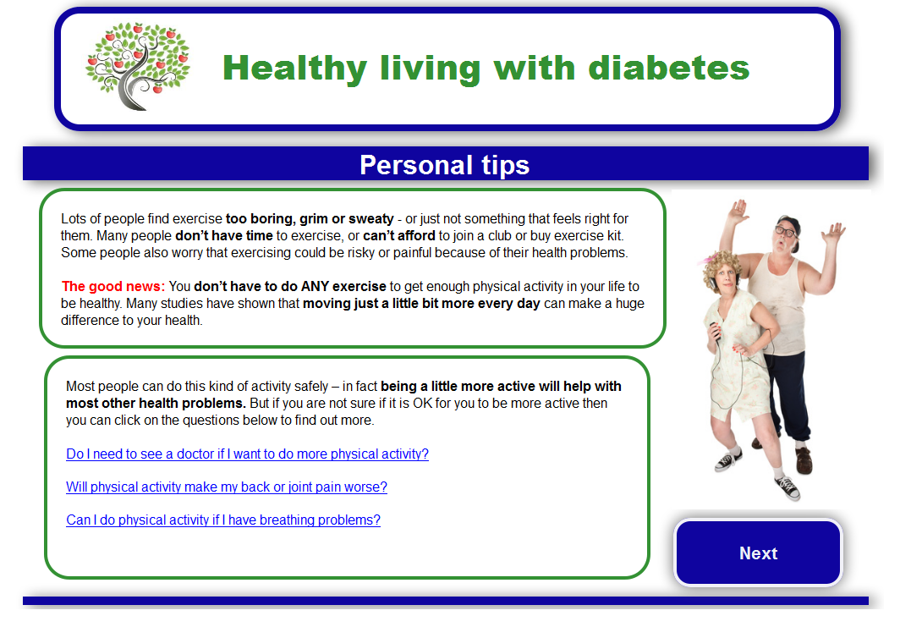

Slide 19
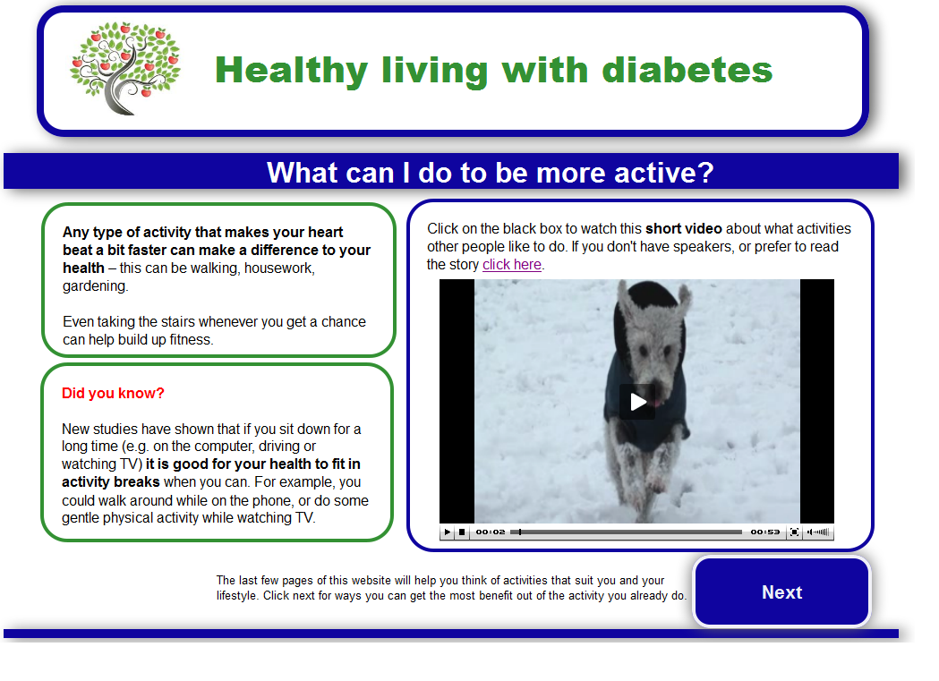

Slide 20
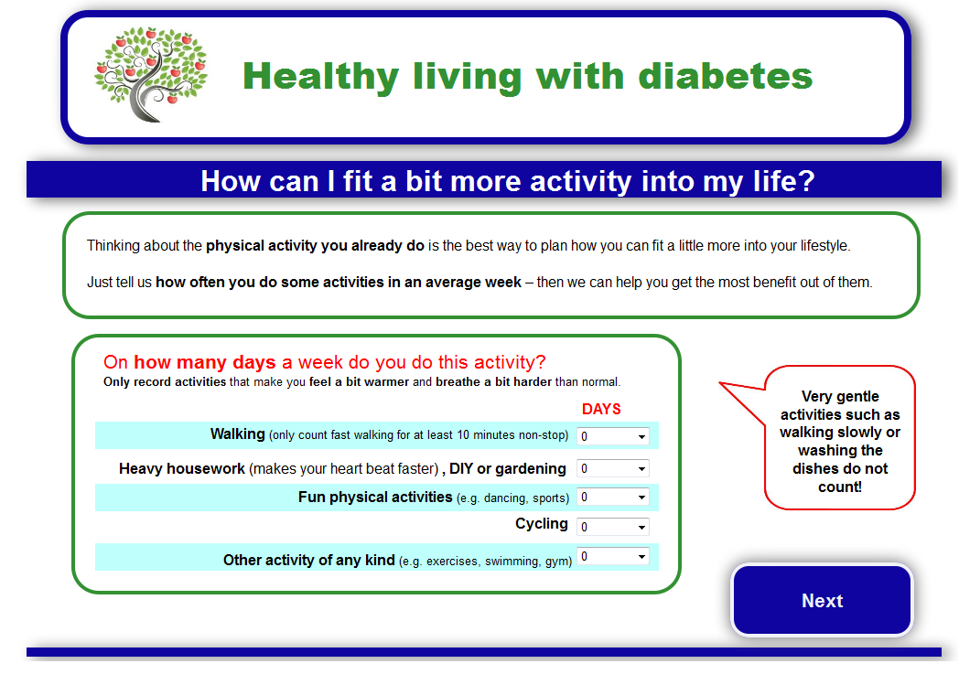

Slide 21
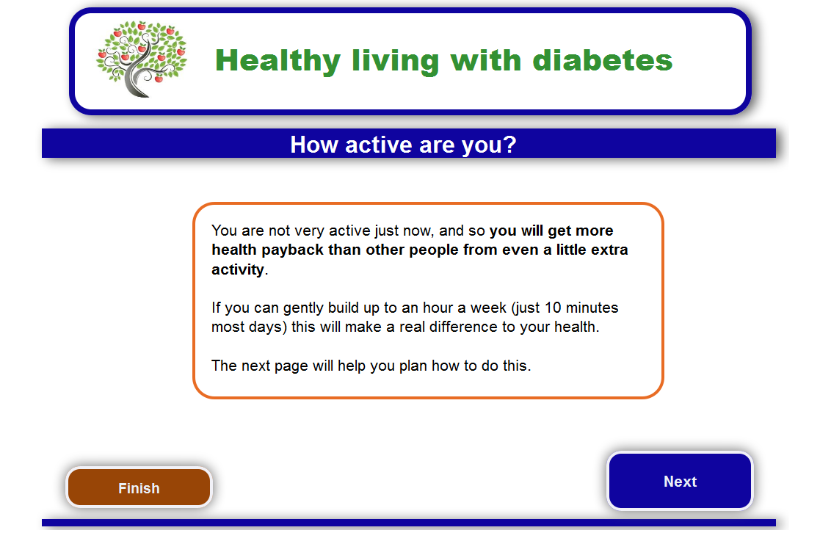

Slide 22
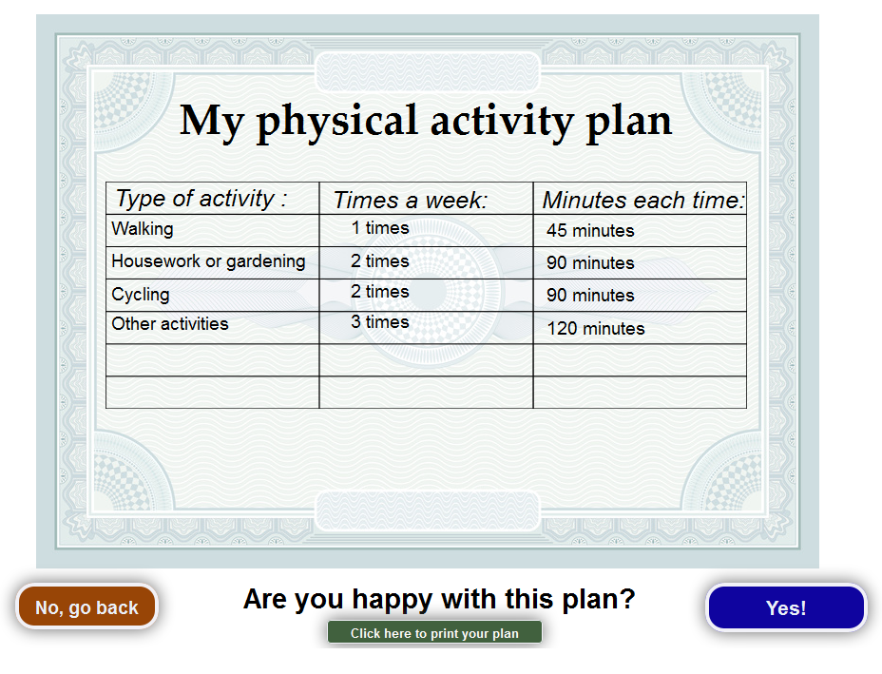

Slide 23
Example 2: POWeR (Positive Online Weight Reduction)
POWeR1 for obese patients in primary care, studying varying levels of nurse support – feasibility study (n < 200), 12 months effectiveness similar to WeightWatchers
POWeRPlus (24 sessions) now being trialled (n = 790)
Rolled out by public health teams in the community (first roll-out n > 1000, 2nd roll-out starting Sept 2014)
Modified for use in numerous further interventions: for hypertension (SMILE/DIPSS), diabetes (HELP-Diabetes), Royal Navy, exercise referral schemes …

Slide 24
Example 3: INTRO
web-based GP education to reduce antibiotic prescribing/resistance across Europe
intervention created in UK, translated/modified for Spain, Poland, Belgium, NL
developed and piloted qualitatively in 11 months (using LifeGuide Community Website)
trialled in 246 practices, successfully reduced prescribing (ca. 20%), published in Lancet
now to be disseminated via GP education websites (CLAHRC, Belgium etc.)

Slide 25
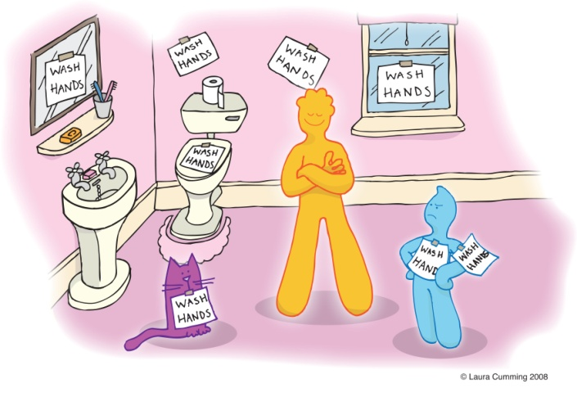
Example 4: PRIMIT
WHO/DoH advised hand-washing during last flu pandemic to prevent spread of infection – but actually no good evidence it is effective, no interventions to support it
Developed 4 session intervention to increase hand-washing, trialled in > 20,000 adults in UK
Reduced respiratory infections (frequency, severity, consultations)
Also benefited household members, gastrointestinal infections

Slide 26

Where next?
LifeGuide
Funded by EPSRC to create LifeGuide software for smart phones – first trials this year
Dissemination of interventions – through CLAHRC, commercial exploitation, international collaborations
E-public health
Technological and behavioural challenges successfully addressed, now need to address challenge of creating sustainable business models for e-health …

